Slide 1
Prayers
narayanam namaskritya naram chaiva narottamam
devim sarasvatim vyasam tato jayam udirayet
Before reciting this Srimad-Bhagavatam, which is the very means of conquest, one should offer respectful obeisances unto the Personality of Godhead, Narayana, unto Nara-narayana Rishi, the supermost human being, unto Mother Sarasvati, the goddess of learning, and unto Srila Vyasadeva, the author.
naṣṭa-prāyeṣv abhadreṣu nityaḿ bhāgavata-sevayā
bhagavaty uttama-śloke bhaktir bhavati naiṣṭhikī
By regular attendance in classes on the Bhāgavatam and by rendering of service to the pure devotee, all that is troublesome to the heart is almost completely destroyed, and loving service unto the Personality of Godhead, who is praised with transcendental songs, is established as an irrevocable fact.

Slide 2

Srimad Bhagavatam Canto 1 | Chapter 13 | Verse 2

Slide 3
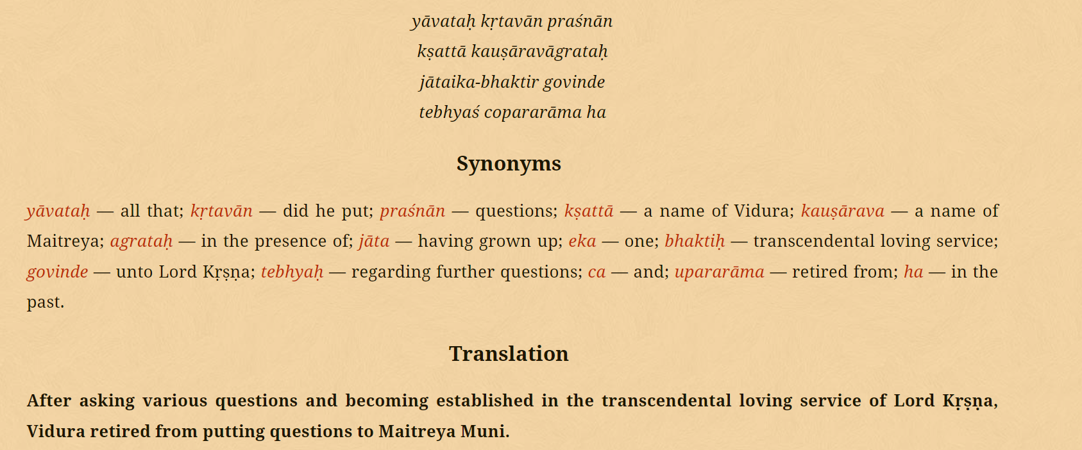
Sloka

Slide 4
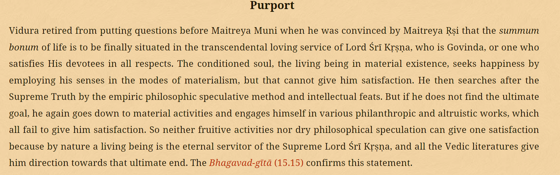
Purport

Slide 5
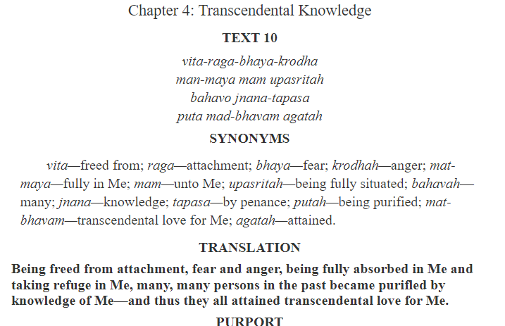

Slide 6
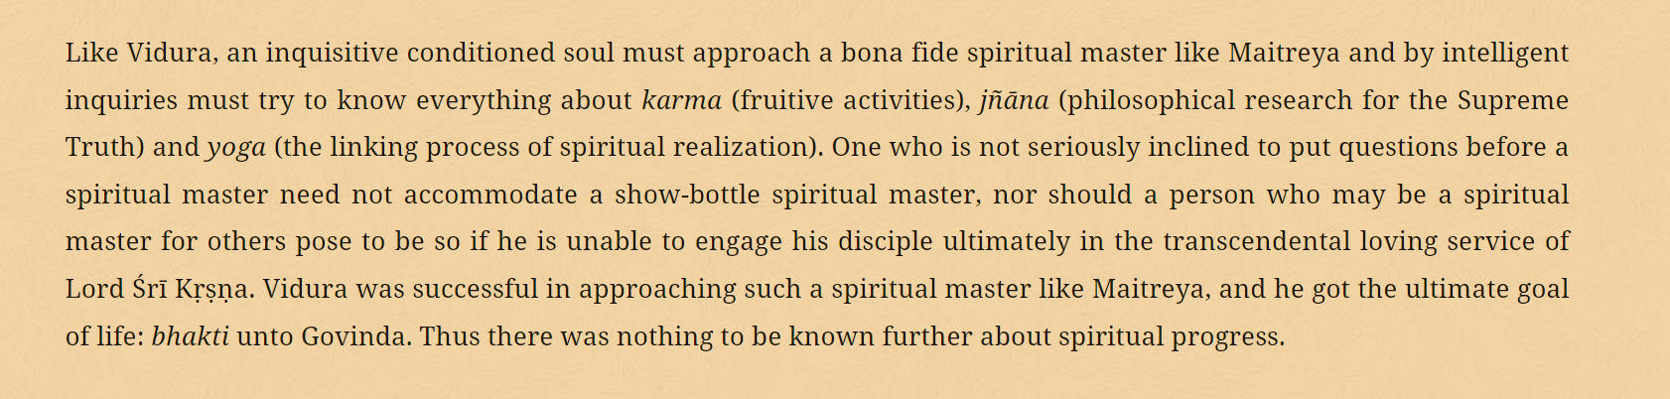

Slide 7
Thank You.

